Slide 1

ER model to schema practice

Slide 2
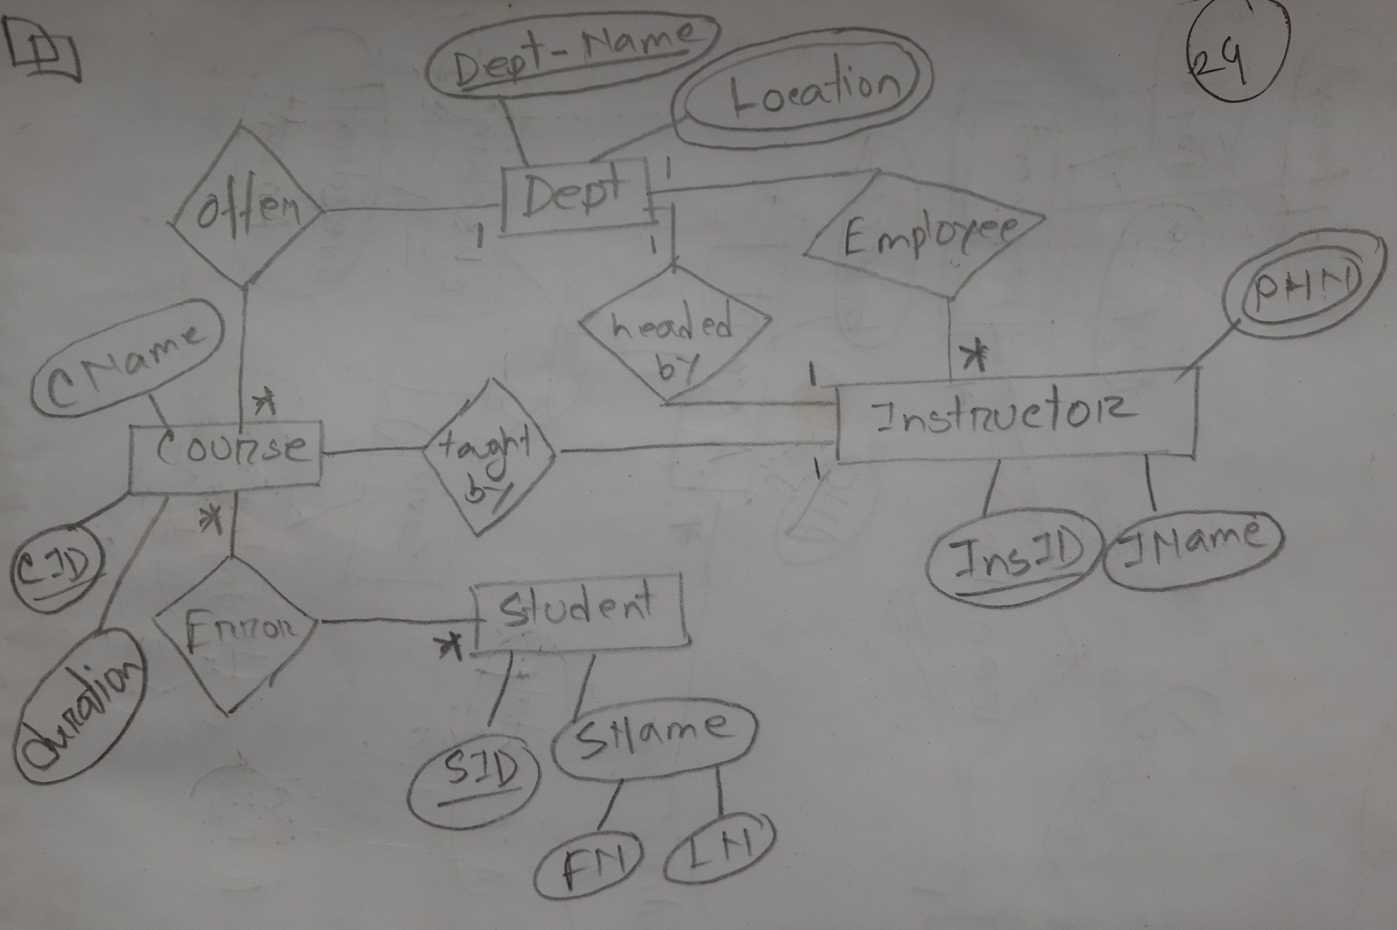
Example 1

Slide 3
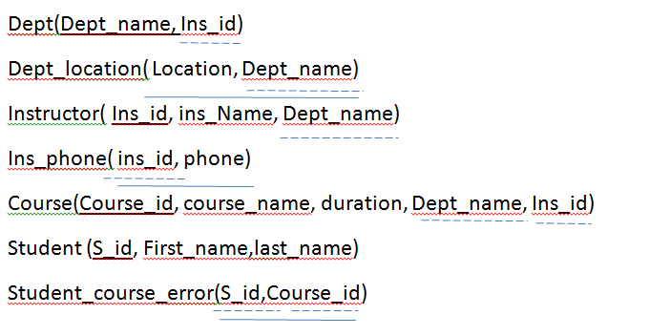
Example 1

Slide 4
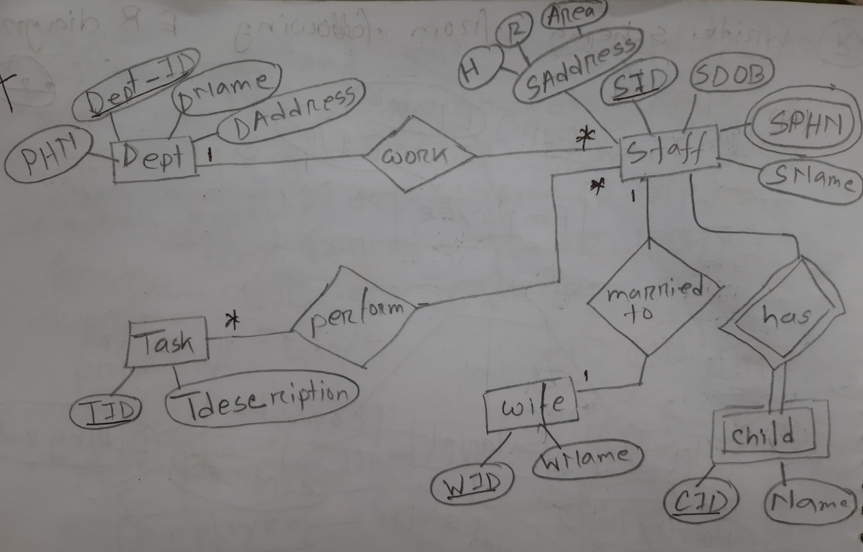
Example 2

Slide 5
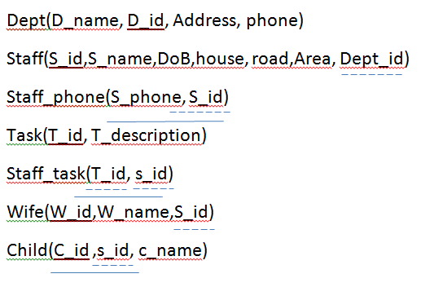
Example 2

Slide 6
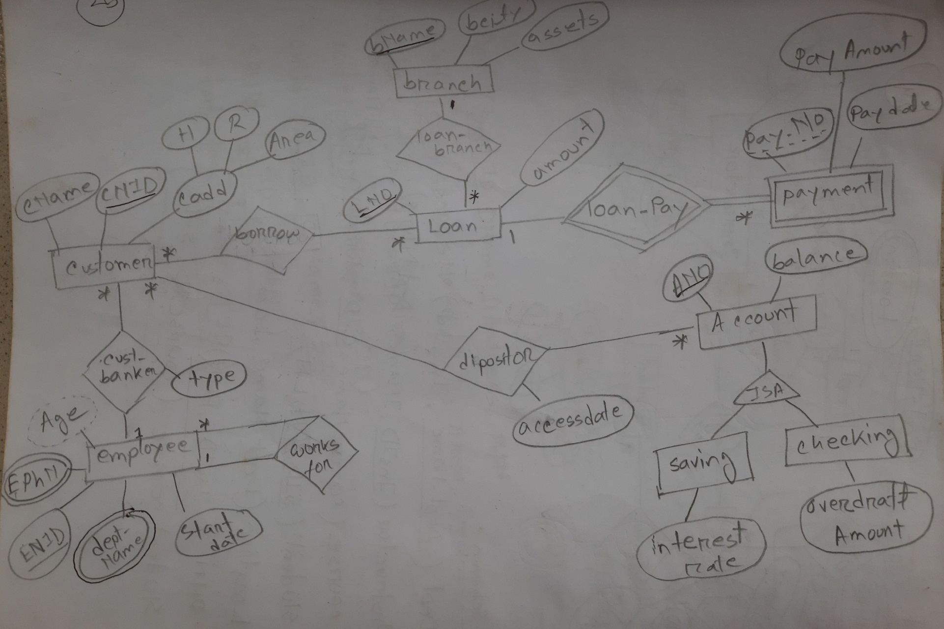
Example 3

Slide 7
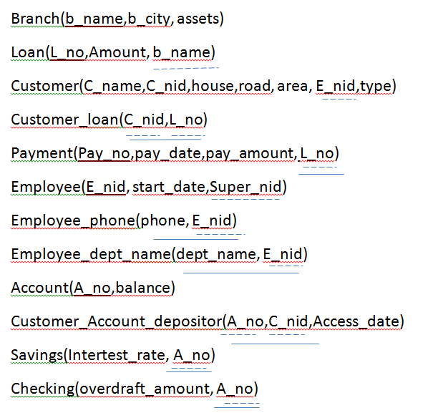
Example 3

Slide 8
Thank you

